Slide 1
Object Oriented Analysis and Design
Object Oriented programming in C++

Slide 2
Encapsulation
Wrapping up data and functions into single unit
Advantages
Restrict access to its internal data
Easy maintenance

Slide 3
Encapsulation
class Student
{
private :
int AM;
int EM;
public :
void ReadMarks()
{
cout<<"Enter Assignment Marks : ";
cin>>AM;
cout<<"Enter Assignment Marks : ";
cin>>AM;
}
};
Because both data members and faction members are included in a single class , this supports encapsulation

Slide 4
Abstraction
Hiding complexity by hiding unnecessary details
Advantages
Restrict access to its internal operations
Hiding implementation complexity
Provide simple interface

Slide 5
Abstraction
class Student
{
private :
int AM;
int EM;
}
Abstraction is provided using access specifies
Public - members declared as Public are accessible from outside the Class through an object of the class.
Protected - members declared as Protected are accessible from outside the class BUT only in a class derived from it.
Private - members are only accessible from within the class.

Slide 6
Inheritance
Forming a new class from an existing class as new class acquires the old class information
Advantages
Code reusability
Reduce development time and effort
Provide specialization
Extendibility
Can extend an already made classes by adding new features

Slide 7
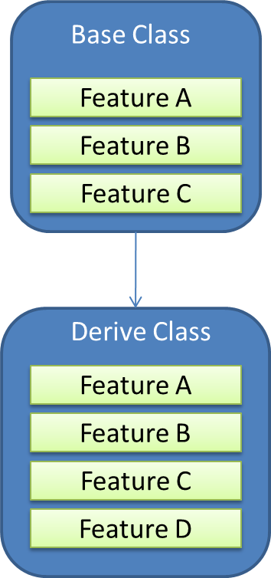
Inheritance

Slide 8
Polymorphism
Polymorphism is the ability of an object to take on many forms.
Allowing operators and functions to behave differently in different context.
Same name can used to deferent functions
Two types of Polymorphism
Overloading
Overriding

Slide 9
Overloading
Ability to create multiple methods of the same name with different implementations.
Use deferent parameters

Slide 10
Overriding
Allows a subclass or child class to provide a specific implementation of a method that is already provided by one of its super classes or parent classes

Slide 11
Dynamic binding
Also known as late binding
Code associated with a given procedure call is not known until the time of call at run time

Slide 12
Message
Request to perform an operation
Function call
Return msg
Communication among objects

Slide 13
Benefits of OOP
Eliminate redundant code
Developing extensible software for future changes
Encapsulation and abstraction helps to develop secure programs
Software complexity can easily manage

